Slide 1

Credit Risk Migration
Steven Esposito

Slide 2
Importing the datasets and merging them
IMPORT
period1 = pd.read_excel('Migration Case Data.xlsx', sheet_name='Period 1')
period2 = pd.read_excel('Migration Case Data.xlsx', sheet_name='Period 2’)
MERGE
merged_inner = period1.merge(period2, on='ID', how='inner’) → common customers from both periods
merged_right = period1.merge(period2, on='ID', how='right’) → common customers plus new customers in period 2
merged_outer = period1.merge(period2, on='ID', how='outer') → all customers from both periods

Slide 3
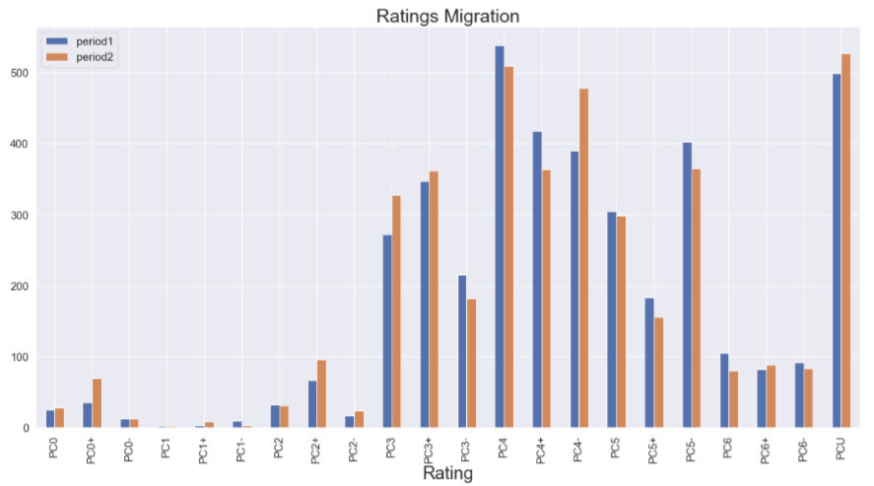
Rating migration (all customers)
Excluding a couple of exceptions, it looks like there has been an increase in low rating
and a decrease in high ratings. Since the Probability of Default is inversely proportional
to the rating, this would suggest that from period 1 to period 2 there has been an increase
in PD

Slide 4
Increased Risk Weight
NEW COLUMN FOR IRW
merged_outer['IRW_1']= merged_outer['RWA_x'] / merged_outer['EAD Amount_x']
merged_outer['IRW_2']= merged_outer['RWA_y'] / merged_outer['EAD Amount_y’]
SEPARATE DATASET FOR IRW
IRW_outer = merged_outer[['ID','IRW_1','IRW_2’]]
IRW_outer = pd.melt(IRW_outer, id_vars="ID", var_name="Period", value_name="Values")

Slide 5
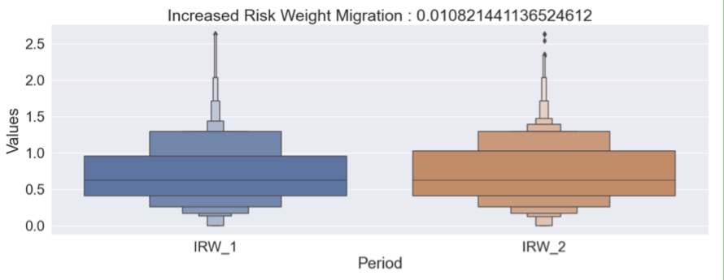
Increased Risk Weight
CALCULATING THE MEAN DIFFERENCE AND PLOTTING THE DISTRIBUTION
IRW_diff = merged_outer.IRW_2.mean()- merged_outer.IRW_1.mean()
g = sns.catplot(x="Period", y="Values",data=IRW_outer, kind="boxen", height=6, aspect=2.6);
plt.title(f'Increased Risk Weight Migration : {IRW_diff}', fontsize=25)
plt.show()

Slide 6
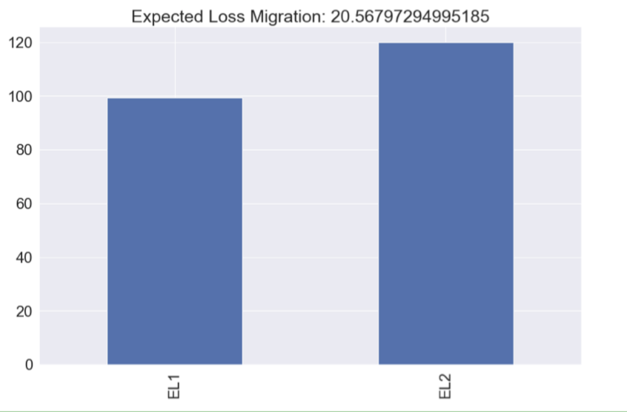
Expected Loss
CALCULATING THE MEAN DIFFERENCE AND PLOTTING THE RESULT
EL_outer = merged_outer[['ID','Expected Loss_x','Expected Loss_y']]
EL_outer = EL_outer.rename(columns={'Expected Loss_x':'EL1','Expected Loss_y':'EL2'})
EL_diff = EL_outer.EL2.mean()- EL_outer.EL1.mean()
EL_cols = ['EL1', 'EL2']
EL_outer[EL_cols].mean().plot(kind='bar',figsize=(14,9))
plt.title(f'Expected Loss Migration: {EL_diff}', fontsize=25)

Slide 7
Impact of new customers VS existing customers
So far, I have analyzed data taking into account all the customers: the ones that appear in both periods and the ones appearing only in one of them. How to measure the impact of new customers and existing customers?
I will do this by comparing metrics between the 'merged_inner' set (containing common customers between the two periods) and the 'merged_right' one (containing common customers plus the new customers that appear in period 2).

Slide 8
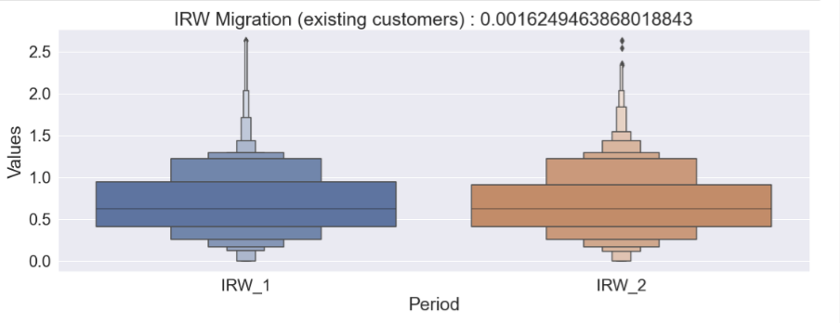
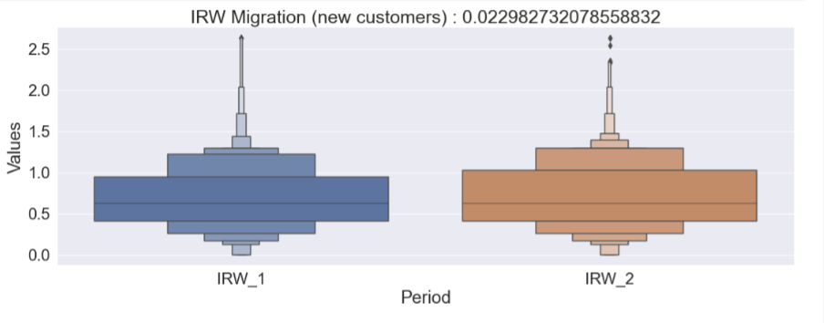
Increased Risk Weight

Slide 9
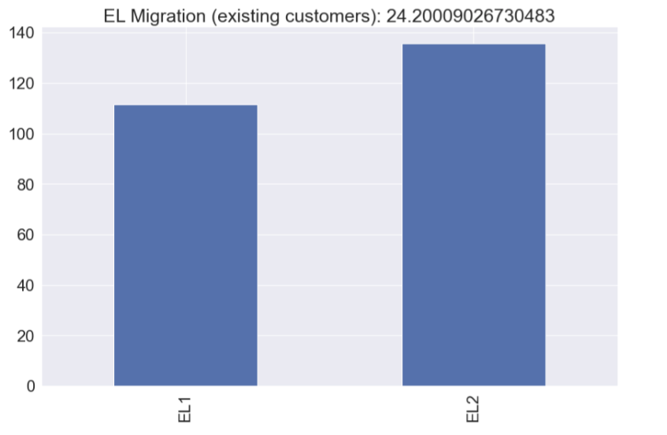
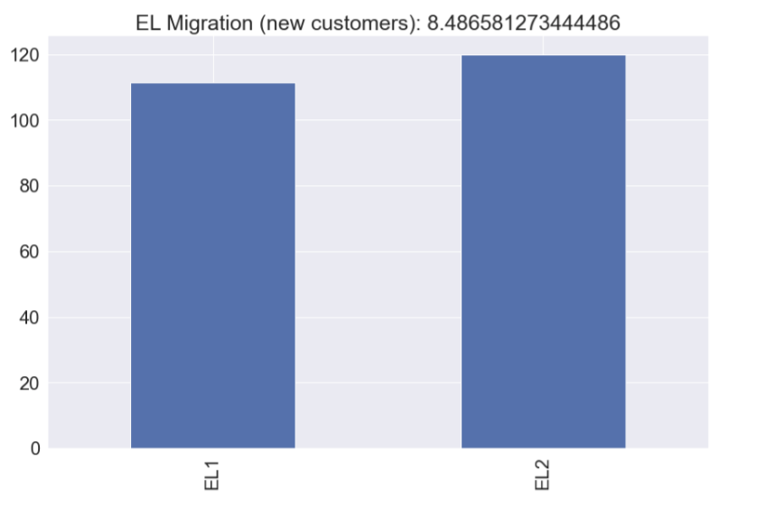
Expected Loss

Slide 10
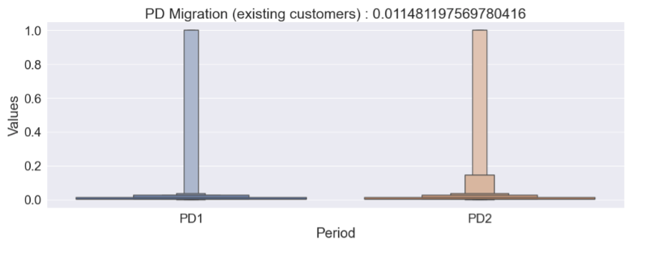
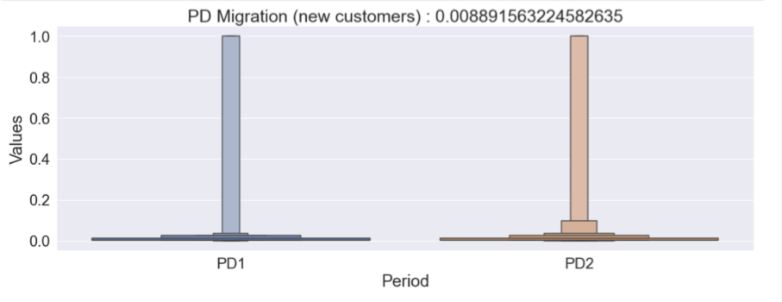
Probability of Default

Slide 11
Impact of unrated and defaulted customers
The previous graphs showed that new customers had a bigger impact on the risk weight, however, it’s the existing customers that seem to influence the rise in PD and EL the most.
What about the impact of unrated and defaulted customers? In order to answer this, I will first create a new dataset by dropping unrated and defaulted customers, then compare metrics with the dataset that contains all customers from both periods.

Slide 12
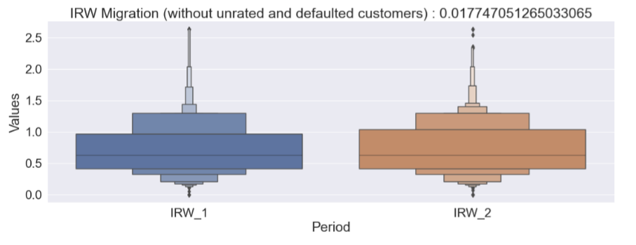
Increased Risk Weight

Slide 13
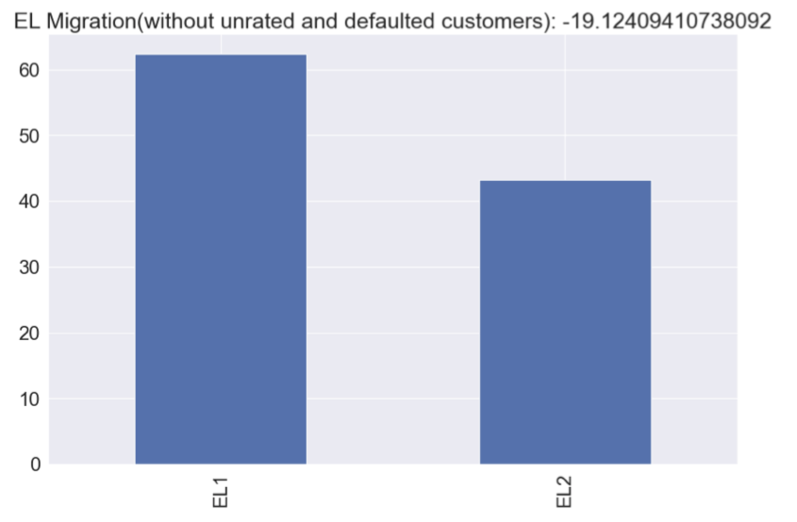
Expected Loss

Slide 14
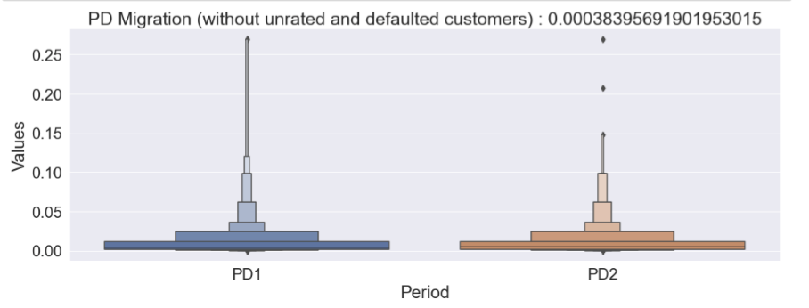
Probability of Default

Slide 15
Impact of unrated and defaulted customers
Unrated and defaulted customers seem to have a considerable impact on EL and PD. Without them, these two metrics would be considerably lower.

Slide 16
Which customers have increased/decreased capital consumption the most
In order to answer this question, I will create a new column that will register the difference in capital requirements between period1 and period2. I will do my analysis considering the existing customers but excluding unrated and defaulted customers; for this I will first create a new dataframe 'merged_drop_inner’.
CREATION OF A NEW DATASET AND NEW COLUMN
merged_drop_inner = period1_drop.merge(period2_drop, on='ID', how='inner')
merged_drop_inner['Capital Requirement_diff'] = merged_drop_inner['Capital Requirement_y'] - merged_drop_inner['Capital Requirement_x’]
CREATING A SEPARATE DATASET FOR CAPITAL REQ AND SORTING VALUES BY ’Capital Requirement_diff’
capital_df = merged_drop_inner[['ID','Capital Requirement_x','Capital Requirement_y','Capital Requirement_diff']]
capital_df = capital_df.sort_values(by=['Capital Requirement_diff'])

Slide 17
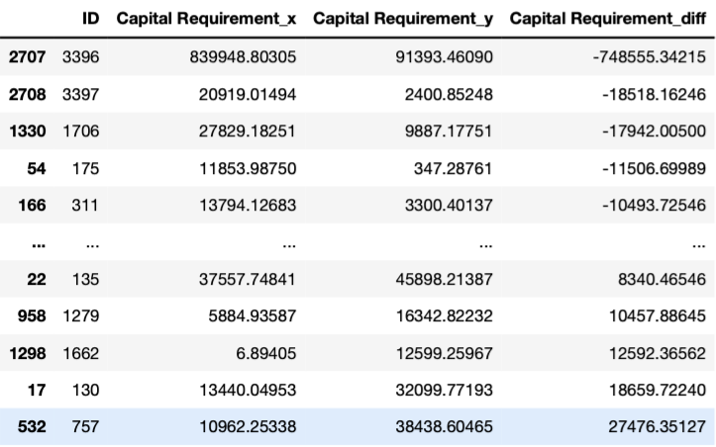
Customers 3396, 3397,1706,175,311 have the lowest difference in Capital Requirement across
the two periods, while customers 135,1279,1662,130,757 show the highest difference.

Slide 18
Thank you!
Steven Esposito

